Slide 1
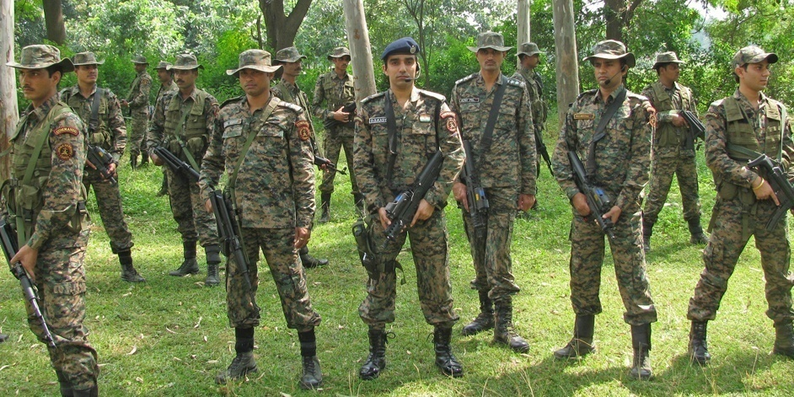
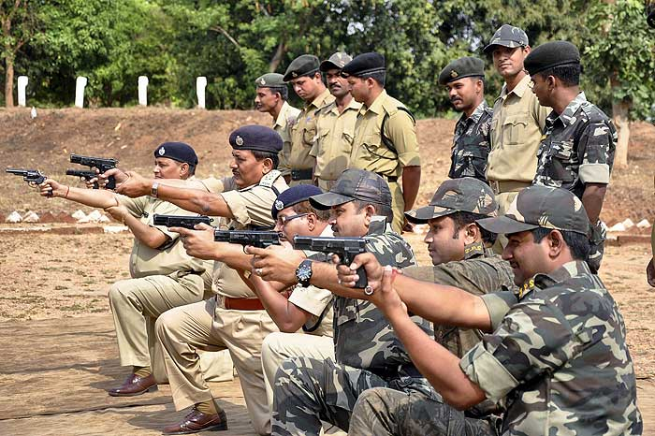
Internal Security in India- Understanding Insurgency in North East
Compiled by: Pratik Nayak
Mrunal.org

Slide 2

Introduction
Kautilya wrote in the Arthashastra
A state could be at risk from four different kinds of threats
Internal
External
Externally-aided internal and
Internally-aided external
Internal security scenario in India has a mix of all the shades of threats visualized by Kautilya
According to an estimate, 252/640 districts→ affected by varying intensities of subversive, insurgent and terrorist activities
Naxalist/Maoist-173 district
Separtists,Terrorist in J&K-15 district
Ethnic insurgents outfits-64 districts of NE India
Mrunal.org

Slide 3
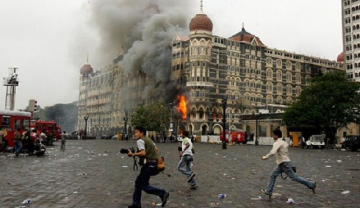
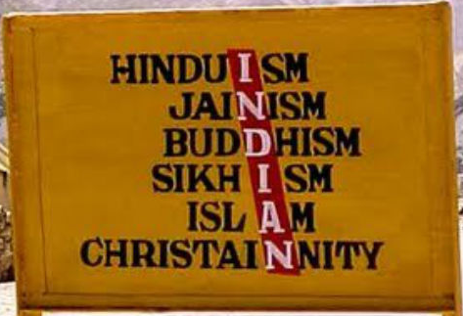
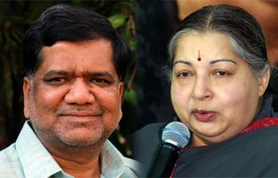
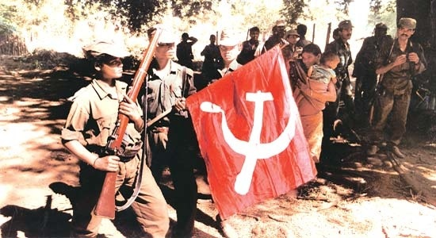
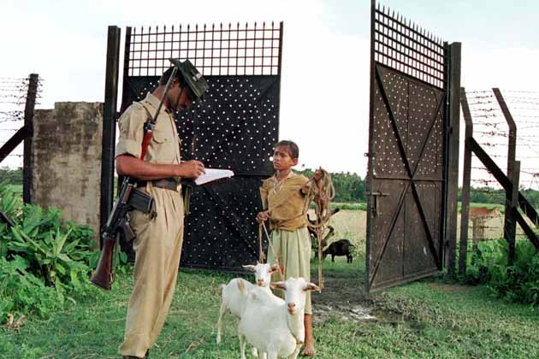
Major Challenges
Threat of terrorism, international and domestic
China fishing in the troubled waters of the northeast
Maoist insurgency spreading to other areas largely due to absence of a strategic plan to deal with the problem
Illegal Migration/Movement
Regional aspirations
Inter-state disputes
Communal problems
Caste tensions
Mrunal.org

Slide 4
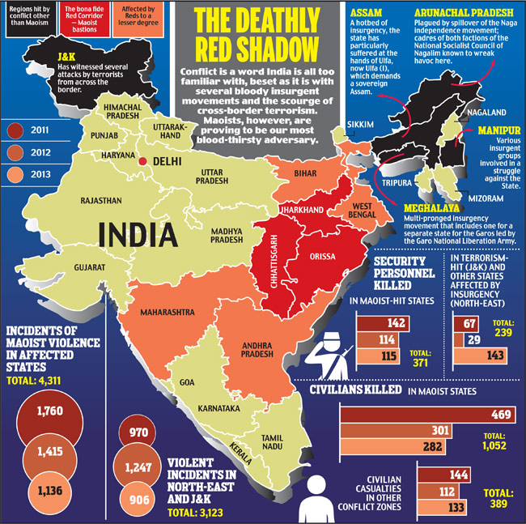
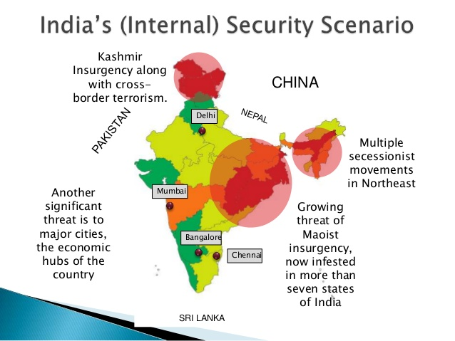
Major Challanges
Mrunal.org

Slide 5
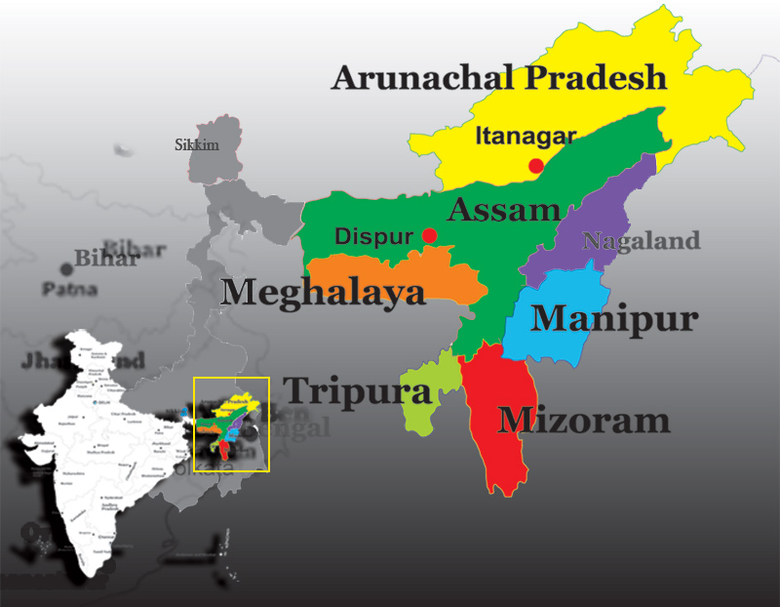
Northeast
Mrunal.org

Slide 6
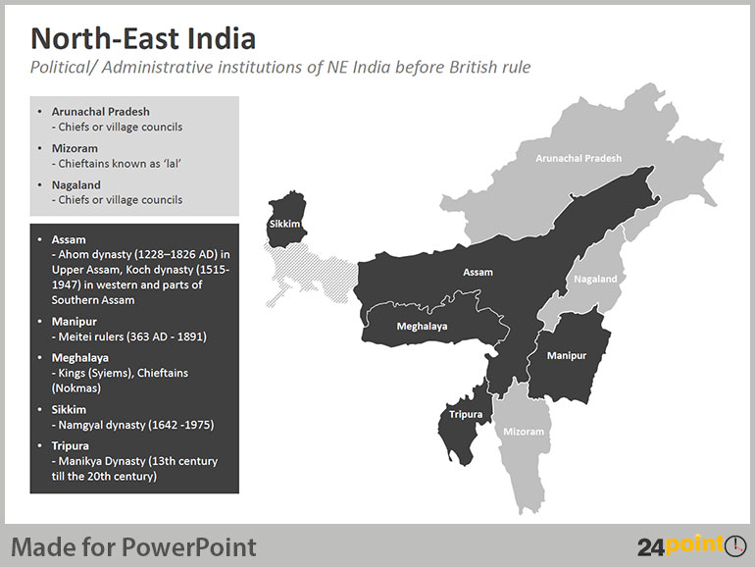
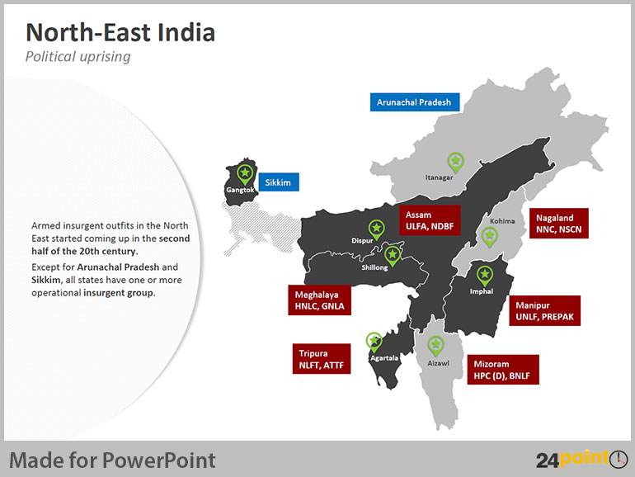
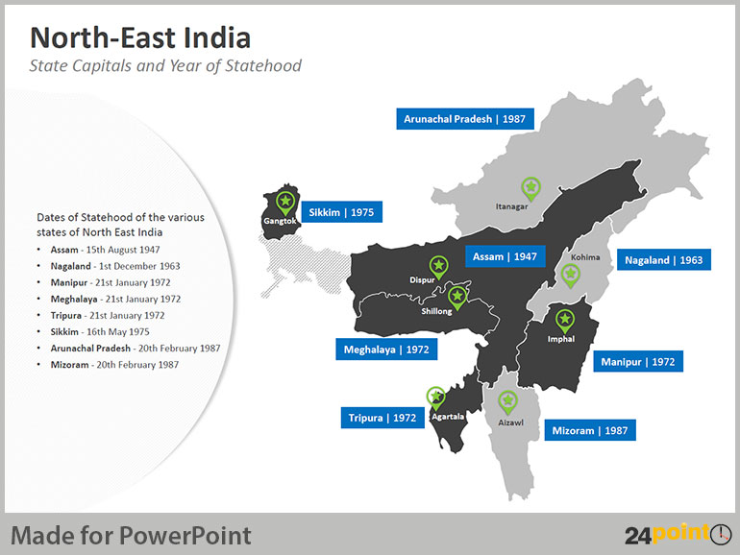
Northeast
Mrunal.org

Slide 7
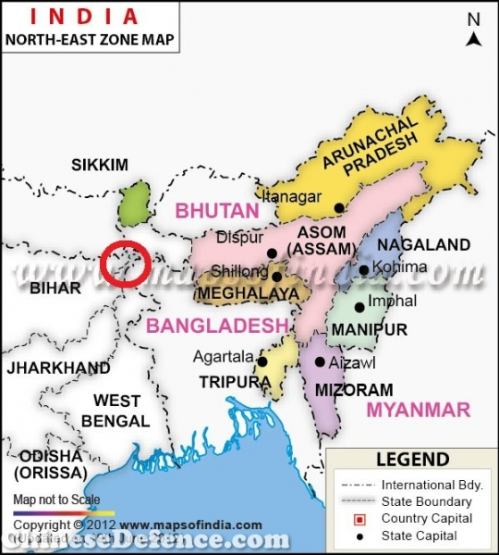
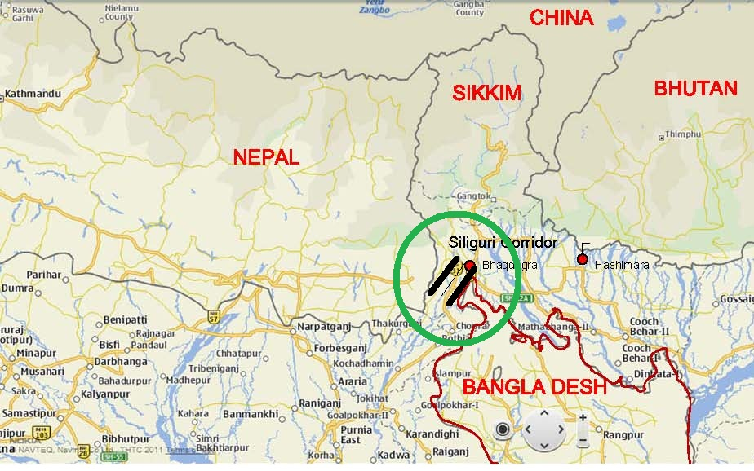
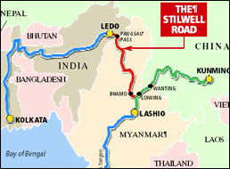
Northeast
One of most geo-strategic landscapes of India
7 Land Locked states
Only one 22-30 km wide corridor links these states to main land India
Silliguri Corridor- Chicken’s neck area
China →territorial claim on, Arunachal Pradesh, is a potential source of conflict
Historically these area connected with china through ancient southern silk road- Still well road/ Ledo road
India has also recognized the strategic significance of this
“Look East” policy envisioned in 1991
Proposal to build the “Asian Highway” and “Asian Railway Link” and “Natural Gas” pipeline
Plan to construct a 1, 360km Trilateral Highway from Moreh (India) to Mae (Thailand) via Bagan (Myanmar)
Mrunal.org

Slide 8
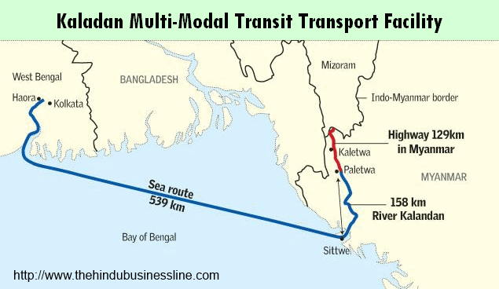
North east
Kaladan Multi-Modal Transit Transport Facility
Purposes of Burmese gas transfer through the Northeast, India is planning to invest $100 million in improving the old colonial Burmese port of Sittwe on the west Myanmar coast
Possible for the North-eastern states to develop individual economic relations with, for instance, Thailand or Vietnam
Can be gateway to south east Asia in future
International border more than 4500 km connecting Bhutan, China, Myanmar, Bangladesh
Extremely heterogenous area- Linguistic, Ethnic and Religious Diversity
Reflected in nature of rebellion groups- secessionist to autonomy, movement against foreigners, integration of ethnic tribes and cultural authoritarianism
Mrunal.org

Slide 9
North east
But the situation of these states has been volatile
2 way fight going on
1. Fight with Indian government and its security forces
2. Infighting among different ethnic groups and their militias
British Policy-leave the Northeast on its own
Independent India – integration of north east provinces in India
Q. But what happened next?
Insurgency- highest in post colonial times
Insurgency through Armed Rebellion – this should have been last option
Mrunal.org

Slide 10
North east
Conflict
National
Ethnic
Sub regional
National-Concept of homeland eg. ULFA- Sovereign Asom
Ethnic- Assertion of smaller tribal group against outsiders/immigrants or dominant tribal group
Sub regional- Fighting to recognize sub regional aspiration, conflict with state government or autonomous councils
Mrunal.org

Slide 11
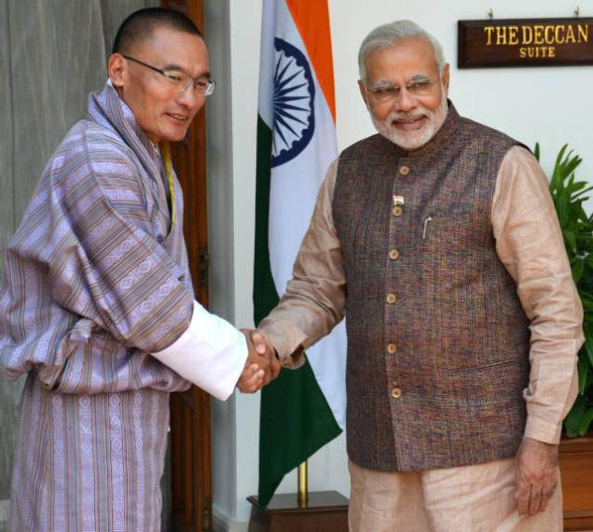
North east
Started with the Naga insurgency in 1947, once upon a time more than 120 groups were operating
They were nothing but the reflection of soical, cultural, political economic setting
Q. What is India doing?
Problem-groups operate across the borders
In past few years, India has taken help of neighbouring countries in its counter-insurgency efforts against the insurgent groups
Coordination issues between the different states of northeast,
Even between central government and state government and central government and foreign government
Mrunal.org

Slide 12
Reasons leading to insurgency
Neglect by the government, sense of apathy, feeling of alienation
Identity crisis- struggling to get their identity established
Eg.Complexities in the relationships between Assamese and non-Assamese
Porous International Border
Changes in the demographic pattern caused by the influx of people from across the borders
Support received by our tribal insurgent groups from their co-tribes in Myanmar territory
Political Mobilisation by local leaders
Lack of Infrastructure and hard terrain to tackle
Only +ve →no involvement of foreign mercenaries in our territory like it has been in J&K
Mrunal.org

Slide 13
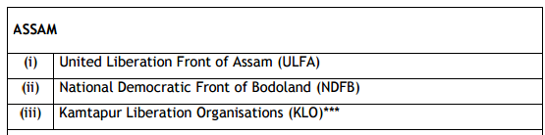
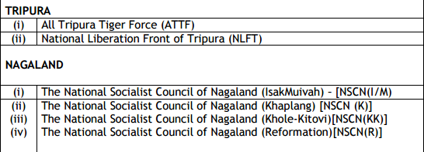
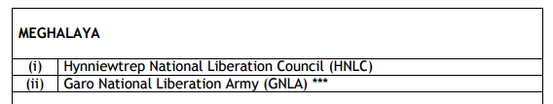
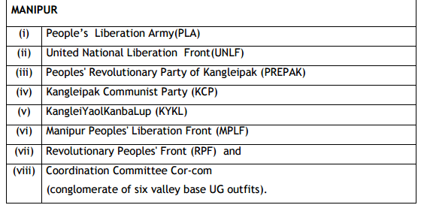
Major Insurgents groups
Mrunal.org

Slide 14
Northeast
Insurgency in Different States
1. Nagaland
→Insurgency
2. Assam
→Insurgency & Autonomy Demand
→Insurgency→ Secessionist Demand
,Autonomy Demand
3.Manipur
4.Mizoram
→ Insurgency → Secessionist Demand→ Later on Pacified
Mrunal.org

Slide 15
Nagaland
Major Tribes
Epi centre of Insurgency
Angami, Ao, Konyak, Lotha, Rengma
Rebelled against the Britishers, demanding→should not be made part of British India
Roots in 1918 →formation of the Naga Club by 20 members of the Naga French Labour Corp→ Served in WW-I
Knowledge from War- Used it once they came back to establish themselves as a distinct political identity
All tribes were included at that time- Angami, Ao, Konyak, Lotha, Rengma, Sema, Yimchunger etc
Submitted a memorandum to the Simon Commission in 1929
People of Naga areas and that of mainland India had nothing in common
Mrunal.org

Slide 16
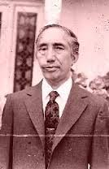
Nagaland
1946-Formation of the Naga National Council (NNC)
Leader→ A.Z Phizo (Anagami Tribe)
Phizo-trained by britishers during 2nd WW, later on this knowledge was given to NNC cadres
1947-Signing of 9 Point Agreement
Akbar Hydari Agreement
Signed Between NNC Leaders T. Sakhrie, Imkonglba Ao And The Governor Of Assam, Sir Akbar Hydari On 29 June 1947
Agreement gave the Nagas rights over their land
Within the ambit of the Indian constitution
executive and legislative powers
Mrunal.org

Slide 17
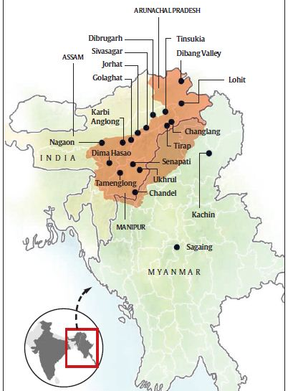
Nagaland
Agreement→ rejected by Phizo. On 14 August 1947, the NNC declared independence
Demand for Greater Nagaland or Nagalim
1950s, 1960s and 1970s →period of turmoil in Naga history →militancy on the rise ← Govt.’s military response Passing of the Armed Forces (Special Powers) Act, 1958
Efforts at peace tried with the grant of statehood to Nagaland in 1963
Establishment of a peace mission in 1964
Finally in 1975, Shillong Accord was signed by NNC under Z. Huire
Q. What circumstances compelled the signing of this accord
loss of bases in East Pakistan in 1972
constant pressure from Indian security forces
Mrunal.org

Slide 18
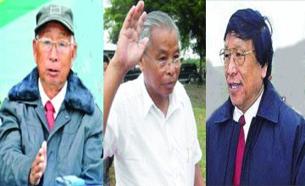
Nagaland
With Signing of Shillong Accord→
split of the Naga rebel movement
Just like Phizo’s said about the Hydari Agreement
3 Leaders Muivah, Swu and Khaplang condemned the Shillong Accord as a sell out to the Union government and formed the NSCN in Myanmar in 1980
Later on, due to intense differences with existing leadership Isak Chisi Swu and Thuingaleng Muivah formed NSCN (IM) [The National Socialist Council of Nagalim (Greater Nagaland)] on 31 January 1988
Followed by the further spilt of S. S. Khaplang led faction and formation of the NSCN (Khaplang)
2011, a new NSCN (Khole-Kitovi) group was formed as a breakaway faction of the NSCN (K).
Later on a New NSCN (Reformation) also came into existence
Mrunal.org

Slide 19
Nagaland
1918
Naga Club
1947
Naga National Council(NNC)
1975
1988
NSCN (IM)
NSCN (K)
Shillong Accord
National Socialist Council of Nagaland(NSCN)
2011
NSCN (Khole and Kitovi)
NSCN (IM) and the NSCN (K) were under ceasefire with the Union government since 1997 and 2001 respectively
Mrunal.org

Slide 20
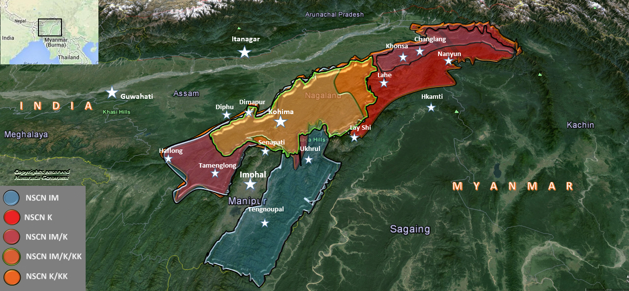
Nagaland
Major issues that are emerging in the Naga conflict
Split in the NSCN (Khaplang) has created a major dent in the influence of the outfit
Support base of the outfit in Naga inhabited areas of Nagaland has reduced
NSCN (IM), views itself as the sole representative of the Naga people in peace talks, is being increasingly threatened on its home turf by the NSCN (Khole and Kitovi) faction
NSCN (Khaplang) is a major threat to the NSCN (IM) as a rival armed actor, its influence in terms of social legitimacy in Naga inhabited areas in India has been limited at best, due to the fact that its Chairman Khaplang belongs to Myanmar
Mrunal.org

Slide 21
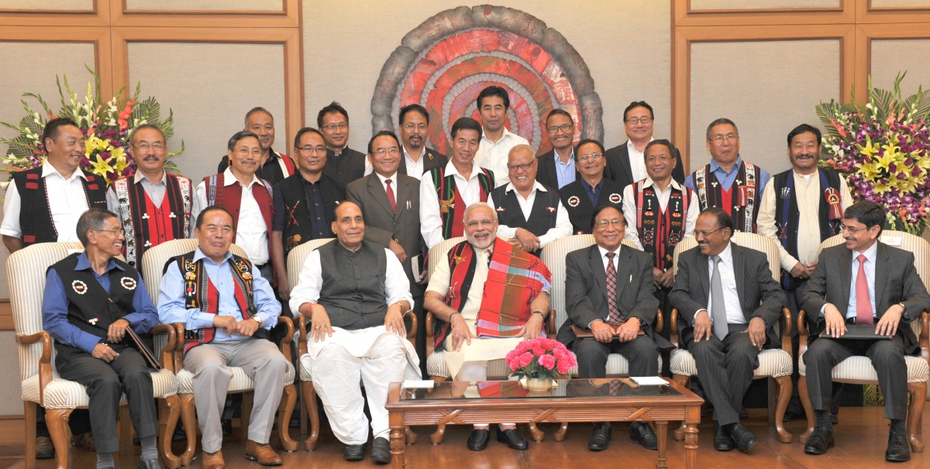
Nagaland
Recent Development
3 August 2015
Signing of the ‘framework agreement’ between the Government of India and the National Socialist Council of Nagaland’s Isak-Muivah faction (NSCN-IM)
PM Modi said “Today's agreement is a shining example of what we can achieve when we deal with each other in a spirit of equality and respect, trust and confidence; when we seek to understand concerns and try to address aspirations; when we leave the path of dispute and take the high road of dialogue.”
Cause for euphoria at the clinching of this ‘framework agreement’ with the NSCN-IM is just not there because there are other Naga rebel factions, particularly the Khaplang-faction of the NSCN or the NSCN-K that is now outside the purview of the peace process
NSCN-K abrogated its 14-year-long ceasefire with New Delhi in April 2015 and carried out the biggest attack on the Indian army when it killed 18 soldiers of the in Manipur’s Chandel district 4June 2015
Mrunal.org

Slide 22
Northeast
Insurgency in Different States
1. Nagaland
→Insurgency
2. Assam
→Insurgency & Autonomy Demand
→Insurgency→ Secessionist Demand
,Autonomy Demand
3.Manipur
4.Mizoram
→ Insurgency → Secessionist Demand→ Later on Pacified
Mrunal.org

Slide 23
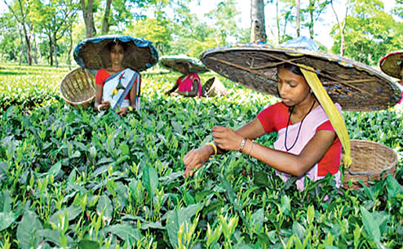
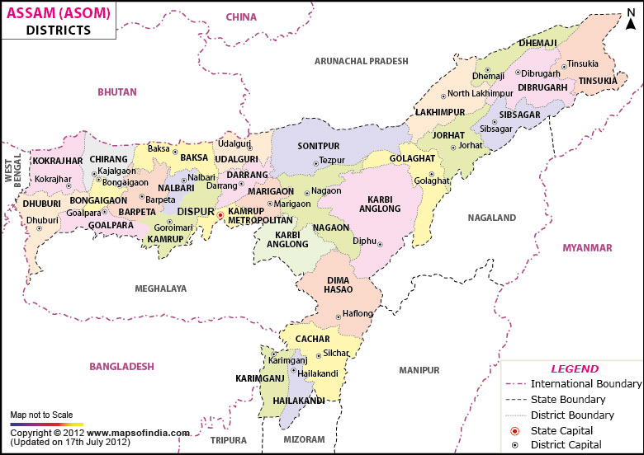
Assam
1st state of NE India post 1947
Radical turn in Assamese nationalism can be traced back to the influx of illegal migrants from East Pakistan after Partition in 1947 and later since 1971 onwards after the formation of Bangladesh
Massive migrant flow created immense anxiety amongst the Assamese middle classes and the rural masses
Violent protests erupted
Assamese thought→ India is exploiting Assam’s oil
Revenues from Assam’s other famous product—tea—were also going to the head offices located in West Bengal
Most proximate cause of the Assam Agitation (1979-1985) was however malpractices in the electoral procedure in 1978
All Assam Students’ Union (AASU) led an agitation demanding the 1951 National Register for Citizens be utilized to determine the citizenship of all those living in Assam
Mrunal.org

Slide 24
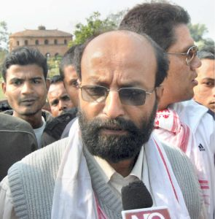
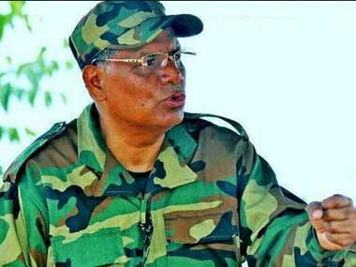
Assam
State tried to use force and suppress the agitation
Creation of one of the most persistent of violent ethnic movements in Assam—the United Liberation front ofAsom(ULFA)
7 April 1979 -ULFA was formed on at Ranghar, in Sivasagar, a sight of historical significance since the time of the Ahom rule
ULFA wants Assam’s status to the Ahom ruled Assam, pre-1826 treaty of Yandaboo between the British and the Burmese, which brought in British rule in Assam
Recruits of the ULFA were drawn from the Asom Jatiyabadi Parishad (AJYCP)-Swadhin Asom→ (Independent Assam)
Paresh Baruah
ULFA’s Vice Chairman, Pradip Gogoi stated
that his organization’s political objectives were “Sovereign, Socialist Assam” in which “All indigenous people must stay, all others must leave”
Mrunal.org

Slide 25
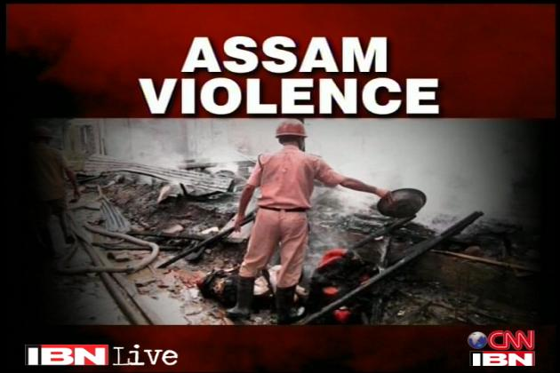
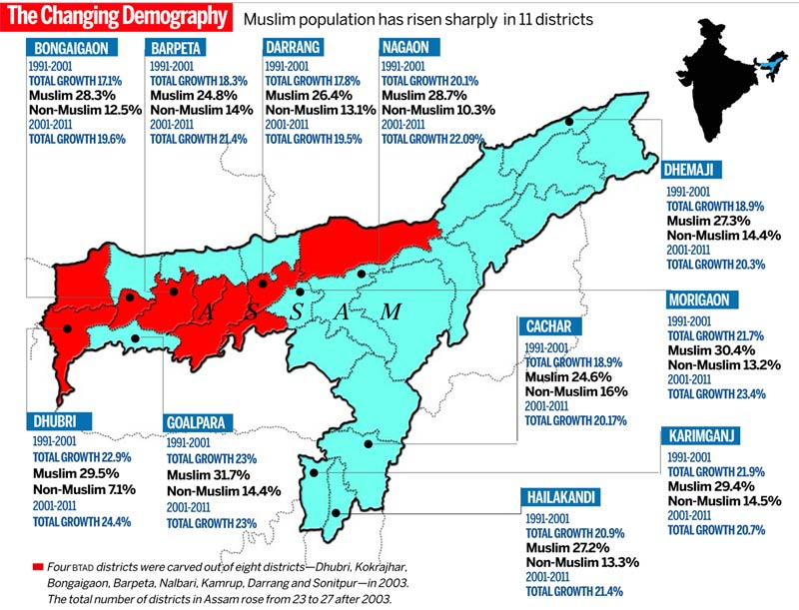
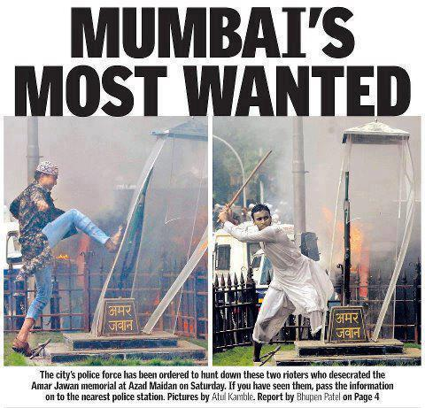
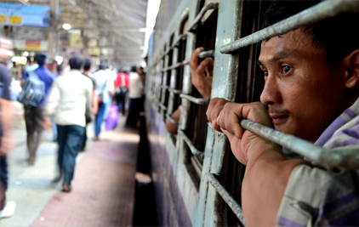
Assam
3 September 2011, peace talk
Tripartite agreement for Suspension of Operations (SoO) against ULFA
Signed between Indian Government, Assam government and ULFA
July 2012, violence broke out with riots between indigenous Bodos and Bengali-speaking Muslims (who were suspected to be illegal Bangladeshi muslims).
Violence in Assam later had its repercussions in other parts of India
Azad maidan riots in Mumbai
Rumour mongering (via sinister
SMSs) triggered exodus of NE Indians
Mrunal.org

Slide 26
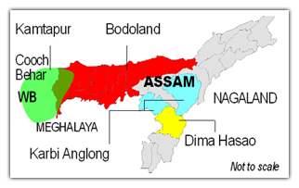
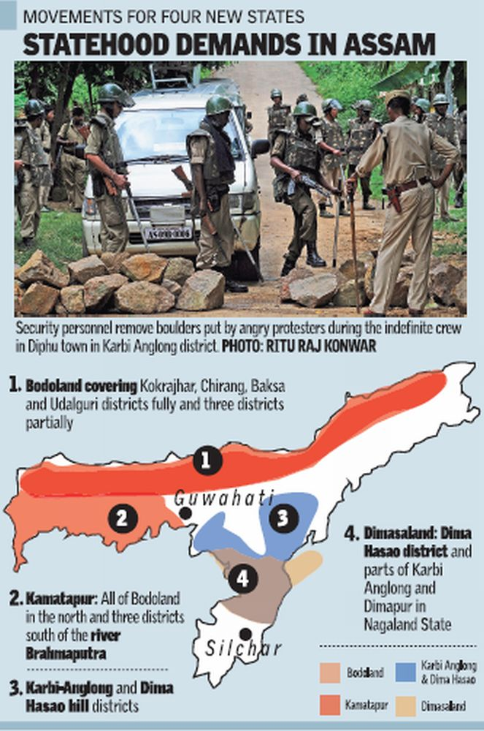

Assam
Statehood demands in Assam
1. Bodoland
2. Karbi Anglong
3.Dimaraji
4. Kamtapur
Post Telangana,revival of statehood movements by four ethnic groups — the Bodos, the Karbis, the Dimasas and theKoch-Rajbangshis
Q. Reasons for demand
General reasons behind their demand of separate statehood
To preserve and promote their ethnic identity
For rapid economic development in backward areas
To ensure control over natural resources like land
Mrunal.org

Slide 27
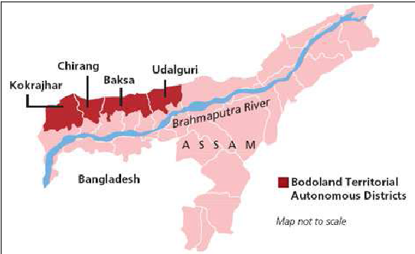
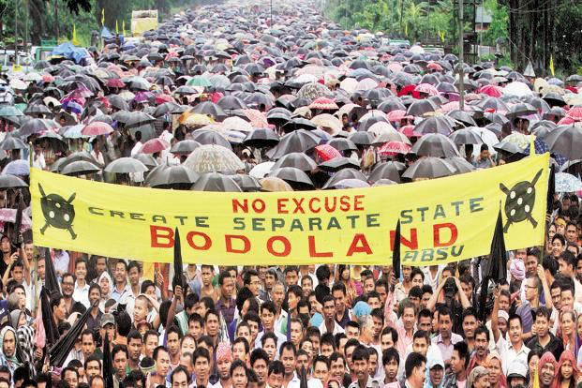
Assam
Statehood demands in Assam
1. Bodoland
Demand for state consisting of areas located extreme north of north bank of Brahmaputra River in the state of Assam, by the foothills of Bhutan and Arunachal Pradesh; inhabited predominantly by the Bodo people
Mrunal.org

Slide 28
Assam
1. Bodoland
Bodoland Movement for an independent state of Bodoland started on March 2, 1987 under the leadership of Upendranath Brahma of the All Bodo Students' Union (ABSU)
Q. Government’s Response?
The Bodoland Territorial Council (BTC)
- BTC has legislative, administrative, executive and financial powers over 40 policy areas in the BodolandTerritorial Areas Districts comprising four districts (Kokrajhar, Baksa, Chirang and Udalguri) of Assam.
- It was established in 2003 following a peace agreement between the Government of India and Bodo rebels and is functioning since 2003 under the provision of the Sixth Schedule of the Constitution of India
Mrunal.org

Slide 29
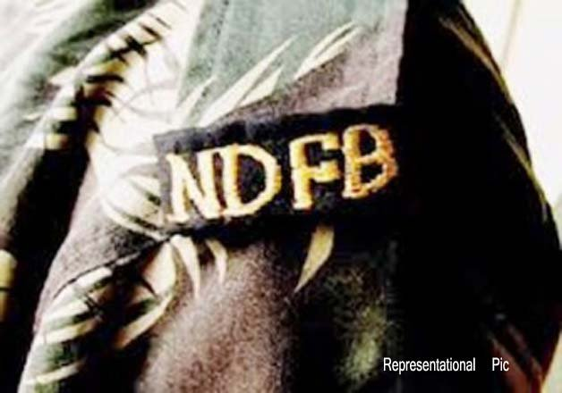
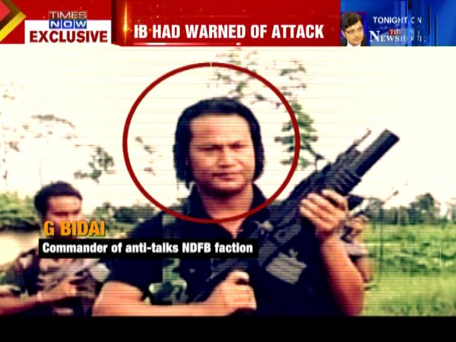
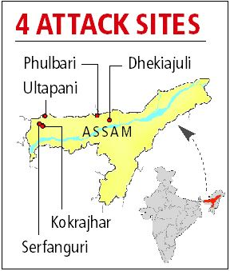
Assam
1. Bodoland
National Democratic Front of Bodoland
Insurgency→ Secessionist Demand
Christian Organisation
Mrunal.org

Slide 30
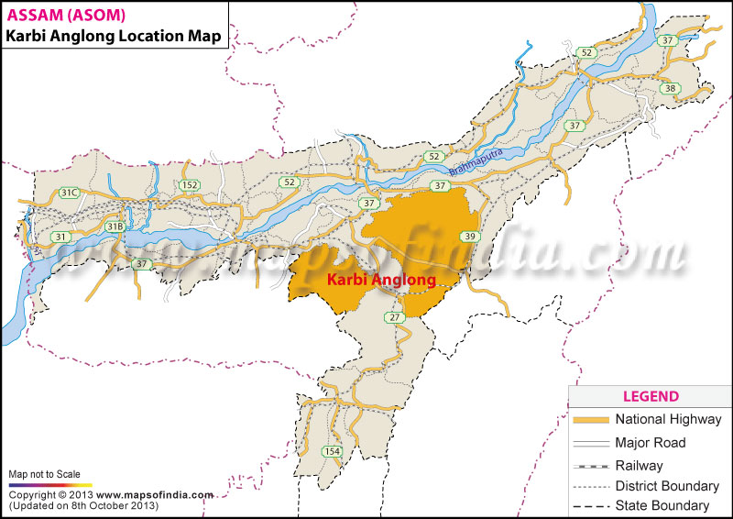
Assam
Statehood demands in Assam
2. Karbi Anglong
Govt. Response?
Autonomous hill districts of Assam in Mikir hills
Demand Separate state of Karbi Anglong (Homeland) is being made by people of Karbi tribe
Karbi Anglong district is the largest amongst the 27 administrative districts of Assam
2006- Indian government named Karbi Anglong one of the country's 250 most backward districts
Mrunal.org

Slide 31
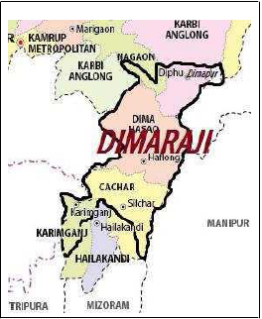
Assam
Statehood demands in Assam
3. Dima raji
Dimsa people demanding a separate state called Dimaraji or "Dimaland"
comprise the Dimasa inhabited Areas
-Dima Hasao district,
- parts of Cachar district,
- parts of Nagaon district and
- Karbi Anglong district in Assam together with
- Part of Dimapur district in Nagaland
Conflict
Govt. Response?
The Dima Hasao Autonomous Council (DHAC)
Mrunal.org

Slide 32
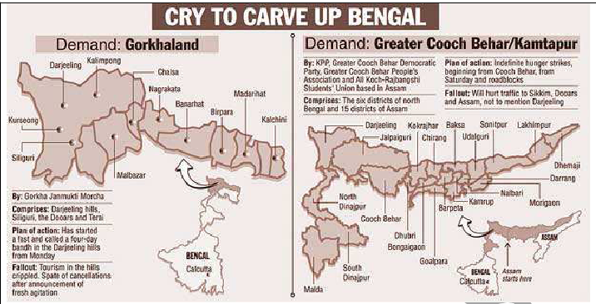
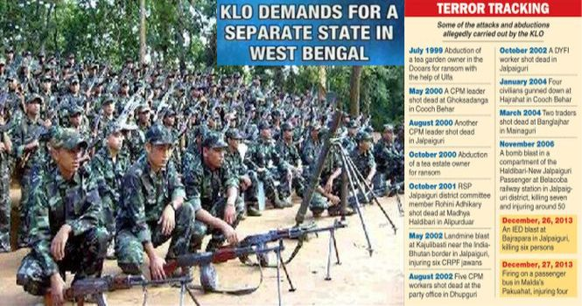
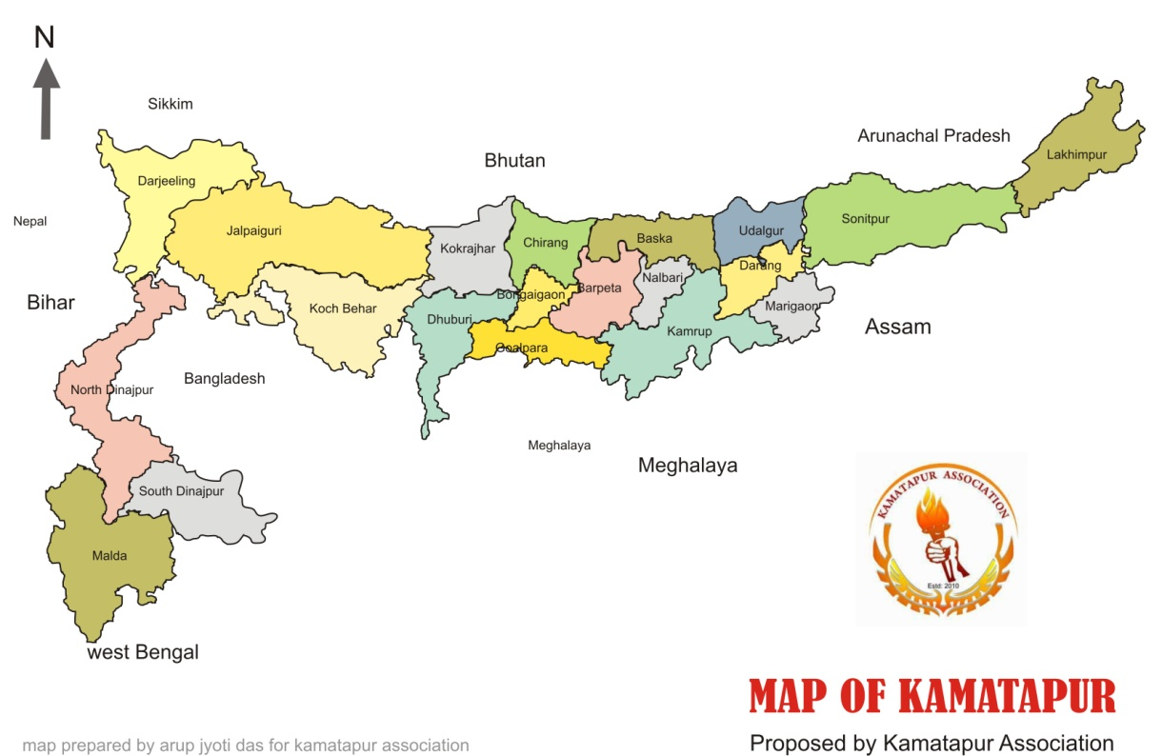
Assam
Statehood demands in Assam
4. Kamtapur
do not have an autonomous council
Demand of state in North West Bengal and Assam by the Koch-Rajbanshis (Rajbongshis) people
some districts of West Bengal
+districts of Assam.
areas demanded under Kamatapur also overlap the areas which were demanded under the statehood of Gorakhland
Conflict:
Rajbanshis-Gorkha
Rajbanshis-Bodo
Insurgency: Kamtapur liberation Organisation
Mrunal.org

Slide 33
Northeast
Insurgency in Different States
1. Nagaland
→Insurgency
2. Assam
→Insurgency & Autonomy Demand
→Insurgency→ Secessionist Demand ,Autonomy Demand
3.Manipur
4.Mizoram
→ Insurgency → Secessionist Demand→ Later on Pacified
Mrunal.org

Slide 34
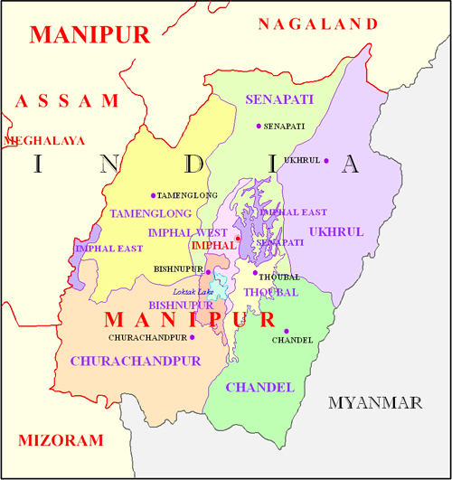
Manipur
January 21, 1972, Manipur became a full-fledged State
Manipur remained an independent kingdom, albeit under British protection
Meitei kings had enjoyed considerable autonomy as long as they respect the colonial interests
Multi-ethnic place in which different ethnic groups have lived in harmony
Inhabited by ethnic groups broadly classified into Meiteis, Meitei-Muslims (65%), Nagas(18%), and Kukis(15%)
Hill areas- Nagas and Kukis
Plain areas- Meitis
Mrunal.org

Slide 35
Manipur
Hill areas- Nagas and Kukis
officially recognized into 29 scheduled tribes owing to their social and economic backwardness
enjoy the benefits of reservations in jobs, education, and welfare programs
Plains -Meiteis and Meitei-Muslims
Considered more advanced they are not recognized as scheduled tribes
They are restricted by law to purchase and own real estate and other land in the hill areas
Nagas and Kukis can buy and own land anywhere in Manipur
This led to sense of frustration among Meiteis
Mrunal.org

Slide 36
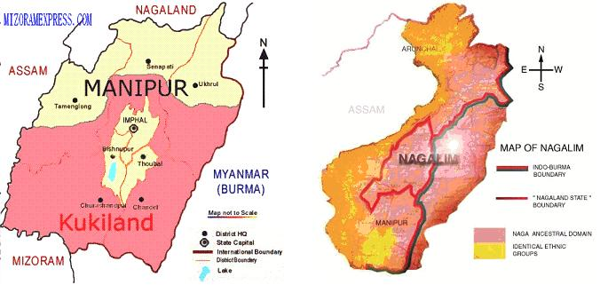
Manipur
both have the tactical support from the adjacent states of Nagaland and Mizoram
Nagas demand for Nagalim
Meiti
Nagas
Kukis
Kukis demand for Kukiland
Kukis and Nagas are calling for separate administrative arrangements in the hill areas
Meitei's, →want territorial integrity of the State
Majority of the Meiteis have been converted into Hinduism
Majority of Nagas and Kukis have also been converted into Christianity
Communal
Land and struggle for Identity are two major bones of contention between Kukis and Nagas
Mrunal.org

Slide 37
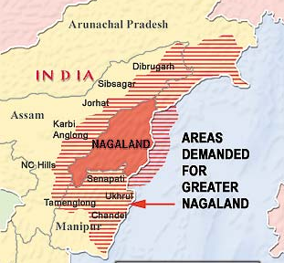
Manipur
Issues of conflict
Nagalim
Naga militant outfit wants to form greater Nagaland by merging Chandel, Senapati, Tamenglong and Ukhrul with neighbouring Nagaland State
To materialize the formation of Nagalim, the Nagas wanted to detach part of Manipur, Assam, and Arunachal Pradesh, and integrate to the adjacent state of Nagaland
Nagalim and the Kukiland are opposed to each other because of their overlapping territorial claims Kukiland is also unacceptable to the Nagas
Kuki
Naga
Mrunal.org

Slide 38


Manipur
Issues of conflict
Meiteilon– the language of Manipur or of just Meiteis
introduced Meiteilon in school education and administration
Kukiland
Kukis have also been demanding the formation of a state to be known as Kukiland within the framework of India’s federalism
resorted to agitations in order to draw the attention of the central government
Zale’n-gam
Kukis want to integrate the Kuki-concentrated areas under one homeland known as Zale’n-gam
Zale’n-gam comprises part of Assam, Tripura, Nagaland, and Manipur in India, part of Sagaing in Myanmar, and part of Chittagong Hill Tracts in Bangladesh
Mrunal.org

Slide 39

Manipur
Insurgency- Secessionist Demand
1964-Estd. main insurgent group United National Liberation Front (UNLF)
Gives historical argument that Manipur was forcefully inducted into India in 1949
support base is mostly from Meiteis
NSCN vs. UNLF- classic “security dilemma”
One ethnic group arms itself, other ethnic groups also arm themselves creating a vicious cycle of “violence” versus “counter-violence”.
Mrunal.org

Slide 40


Manipur
Insurgency- Secessionist Demand
1978-People’s Liberation Army of Manipur (PLA)- objective of liberating Manipur from India
Political arm is the Revolutionary People’s Front (RPF)
Being trained in Maoist guerrilla warfare by the Chinese in
the 1960s and 1970s and both outfits aim at violent revolutionary change
The most lethal insurgent group in Manipur
Mrunal.org

Slide 41


Manipur
Insurgency
1987-88-Kuki National Front KNF with the objectives to counter the NSCN-IM hegemony in the Kuki-inhabited areas and to secure a separate State or Union Territory for the Kuki community
Another armed group is the Kanglei Yawol KannaLup (KYKL), which has taken up social afflictions such as fighting corruption, drug trafficking and sub-standard education practices
Another insurgent group, known as the Peoples’ Revolutionary Party of Kangleipak (PREP-AK), was established in the 1977 with the objective of fighting for Manipur’s independence from India
Mrunal.org

Slide 42
Northeast
Insurgency in Different States
1. Nagaland
→Insurgency
2. Assam
→Insurgency & Autonomy Demand
→Insurgency→ Secessionist Demand
,Autonomy Demand
3.Manipur
4.Mizoram
→ Insurgency → Secessionist Demand→ Later on Pacified
Mrunal.org

Slide 43



Mizoram
Mizo people never considered themselves as a part of british union
Refused to consider themselves part of India post 1947
Was a part of Assam State
1959- Famine in Assam
1960- Official Language Act-Assam
Assamese was made only official language
Apathy shown by Assamese government towards mizo people
Formation of Mizo National Front(MNF)Under
Lal Denga
Armed campaign against Indian army through guerilla war ,also aided by east pakistan government
Mrunal.org

Slide 44

Mizoram
Q. How it was brought under control?
Use of force by India and large scale human loss compelled lal denga for negotiations with Indian government
Signing of the Mizo Peace Accord between the Union government and the Mizo National Front (MNF) led by Pu Laldenga in 1986 after 20 years of insurgency and the grant of statehood in 1987
Lal Denga becomes Chief Minister, end of Mizoram's armed conflict
Mrunal.org

Slide 45





Reasons for the existence of the Armed Ethnic groups
1. Political Mobilisation
2. Easy availability of arms
3.Popular support
4.Area to work- no space constraints
5.External support
Mrunal.org

Slide 46
Reasons for the existence of the Armed Ethnic groups
1. Political Mobilisation
garner popular support for their violent activities by citing a political cause, significantly important to the target population
insurgent groups construct a social imaginary based on real or perceived political alienation and cultural subjugation
visible showcasing of power attracts unemployed youths in areas where the state is unable to provide decent alternative livelihoods
NSCN (IM)- political objective is Naga territorial unification and sovereignty based on the outfit’ s historical narrative of Naga independent status
ULFA utilizes the politics of Assamese exploitation at the hands of New Delhi
Mrunal.org

Slide 47
Reasons for the existence of the Armed Ethnic groups
2. Easy availability of arms
Arms along with other communication gadgets are easily available from across the border especially in Bangladesh and Myanmar
Arms had made it possible to escalate violence levels
3.Popular support
Insurgent groups portray themselves as representatives of a particular ethnic group
ULFA is known for its terror tactics of killing non-Assamese Hindi-speaking people
Acceptance by the society or lack of opposition from state towards all these actions, provide these militant groups an open legitimacy
Mrunal.org

Slide 48
Reasons for the existence of the Armed Ethnic groups
4. External Support
Insurgent groups have thrived primarily due to strong external
influences
China in the 1960s and the 1970s as well as Pakistan and later on Bangladesh have supported most of these outfits by making available arms, training and most importantly, base areas for underground camps
Political, Moral, Military, Economic, Territorial or Cultural and based on ethnic ties
Mrunal.org

Slide 49

Reasons for the existence of the Armed Ethnic groups
4. External Support
ULFA and the NSCN (IM) had/have training camps in Myanmar and Bangladesh
Unified NSCN was formed in Myanmar on 31 January 1980, outside Indian Territory to fight against India for secession
Drug addiction and heroin use is rampant amongst the north-eastern youths due to the easy availability of drugs from Myanmar (or say from ‘Golden Triangle’)
Things have however improved with Bangladesh since 2008 with the coming of Sheikh Hasina to power
Mrunal.org

Slide 50
State Response to this conflict
1. Proportionate use of force.
2. Use of dialogue and negotiations
State Response
3. Structural changes-grant of greater political autonomy and statehood
4.Schemes for NE states-separate Ministry of
Development of North Eastern Region
Mrunal.org

Slide 51
Way ahead
1. Addressing Structural conditions like ethnic alienation, poverty, lack of infrastructure, absence of land right
Improve local public transport and connectivity with rest of the country
empower the common people and give them
respect to their ethnic culture and identity
due respect
political rights
economic basis for a decent livelihood
2.Ensuring efficient law enforcement to create disincentives for armed groups to continue arming themselves
Mrunal.org

Slide 52
Way ahead
3.The conflicting issues between the North-eastern states like land issues/border should be settled at the local level
make governance people friendly
Processes of dialogue and negotiation with armed militant outfits must be conducted in a professional manner by people trained in negotiation techniques
Acts like the Armed Forces (Special Powers) Act, 1958 should be lifted from the Northeast in a phased manner as the common perception of this act is that it is unjust and repressive
Project the idea of India as a democratic nation where people matter and NE population must participate and take responsibility to make it more comprehensive and complete
Mrunal.org

Slide 53
Way ahead
India must ensure that countries like Bangladesh, Bhutan and Myanmar are not used by insurgent groups as launching pads for violence in its border states
Dialogue mechanism in all three countries need to be institutionalized and activated on regular basis
Concrete steps to realize Look East Policy that ensures participation of the Northeast India as it is truly a region that can benefit from globalization
Implementing North East Vision 2020
The best way to respond to armed ethnic conflicts of this nature is through the mechanisms of dialogue and negotiations and through ending their alienation
Mrunal.org

Slide 54
North East Vision 2020
In order to establish peace and prosperity, the document argues that the north east needs to follow the following path
Catching up with the rest of the country;
Structural transformation;
Poverty eradication in North East; Maximising self governance;
Harnessing resources for the benefit of the people;
Building capacity in people and institutions;
Strengthening infrastructure;
Creating a centre for trade and commerce;
Effective governance: establishing peace and harmony
Mrunal.org

Slide 55
North East Vision 2020
To ensure the realization of Vision 2020, the documents construct the following development strategy
Empowerment of people;
Creation of development opportunities;
Developing sectors with comparative advantage;
Capacity development of people and institutions;
Creating a hospitable investment climate;
Significant investment in both public and private sectors
Mrunal.org

Slide 56
Thank You
Mrunal.org

